Slide 1
Battle-Field-3
HQC Team

Slide 2
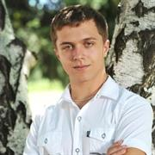
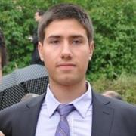
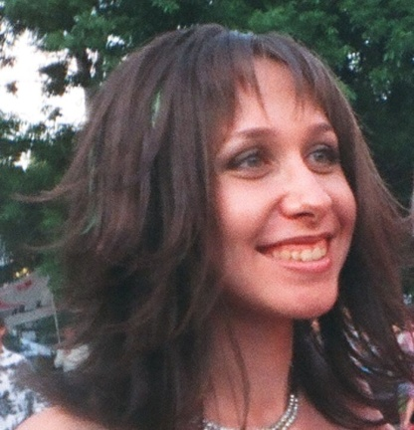
Battle-Field-3
Boris Stoyanov
Peter Milchev
borisstoyanovv
pepinho24
Petya Kostova
pepsi_555

Slide 3
Game description
Refactoring
Unit Tests
Used Design Patterns
SOLID Principles

Slide 4
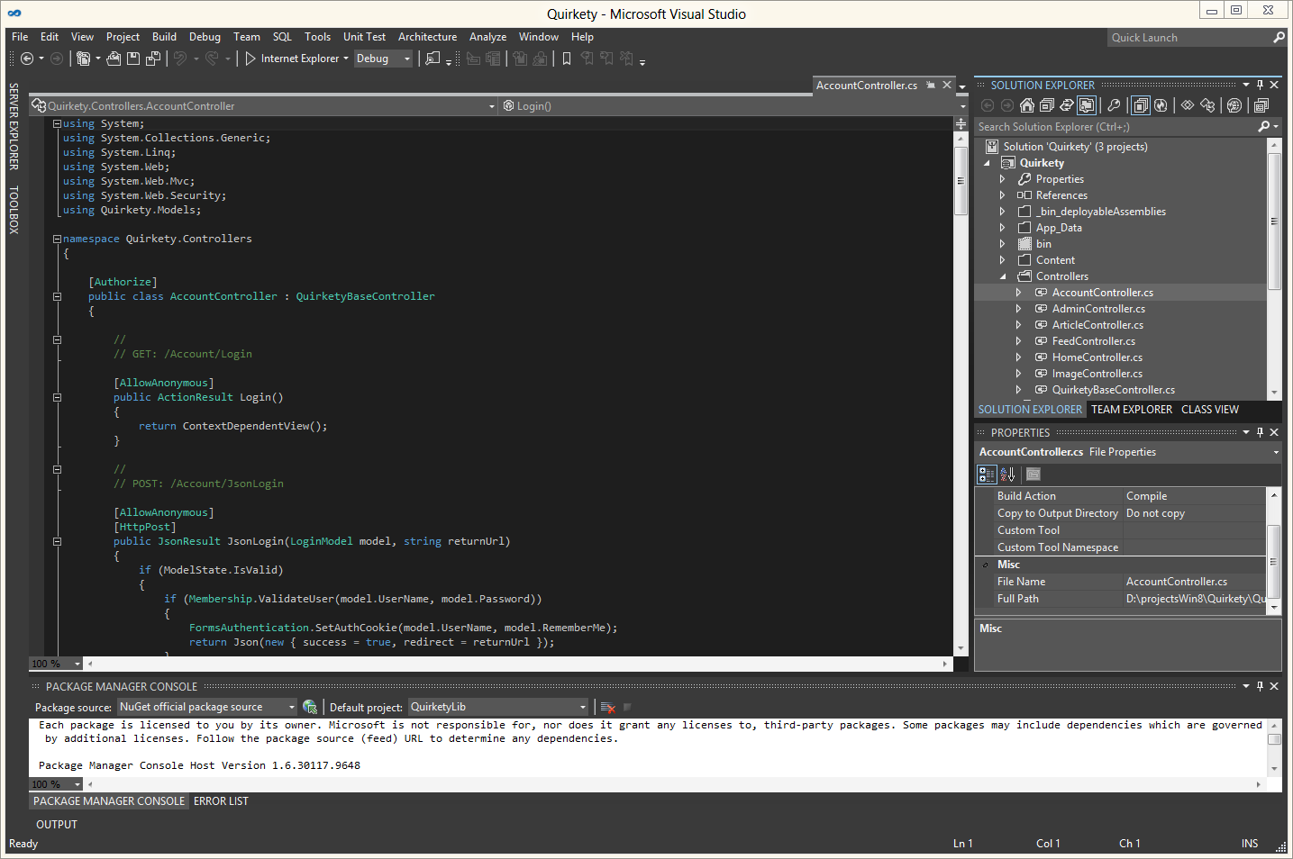
Code Demo

